Slide 1


Computer Architecture Spring 2020
Hamed Farbeh
farbeh@aut.ac.ir
Department of Computer Engineering
Amirkabir University of Technology

Slide 2
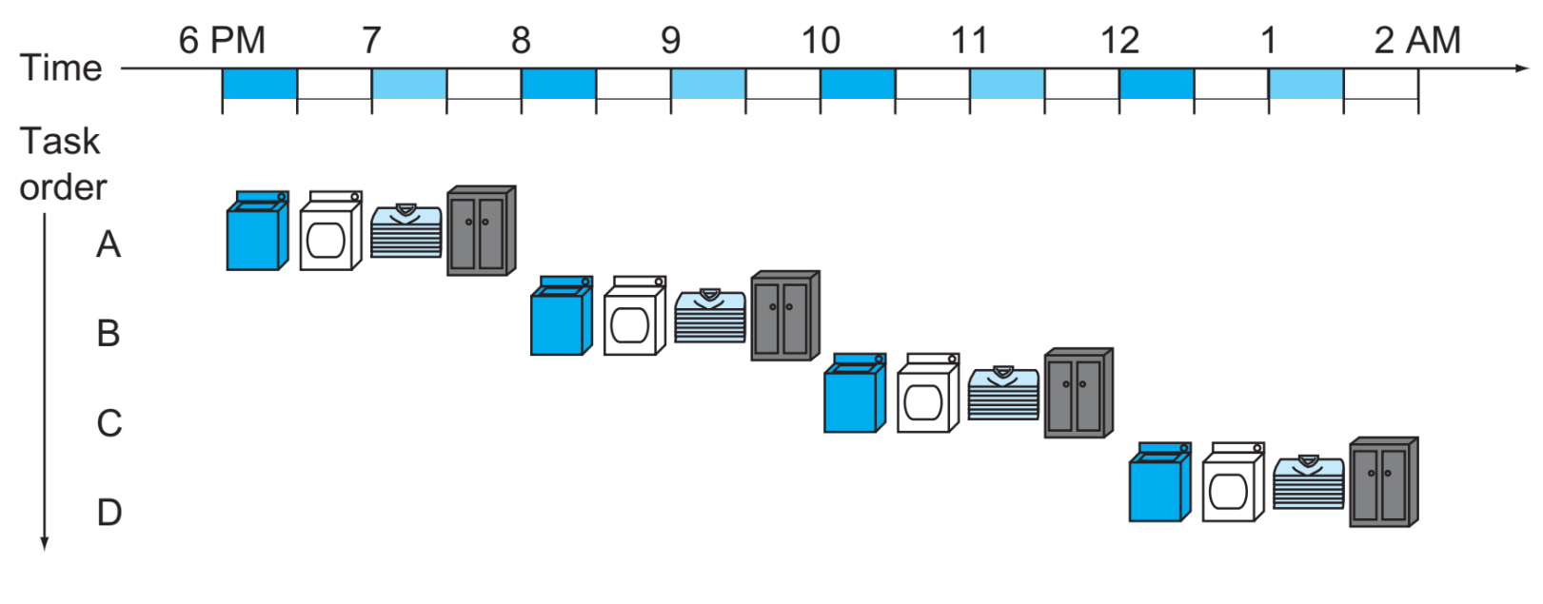
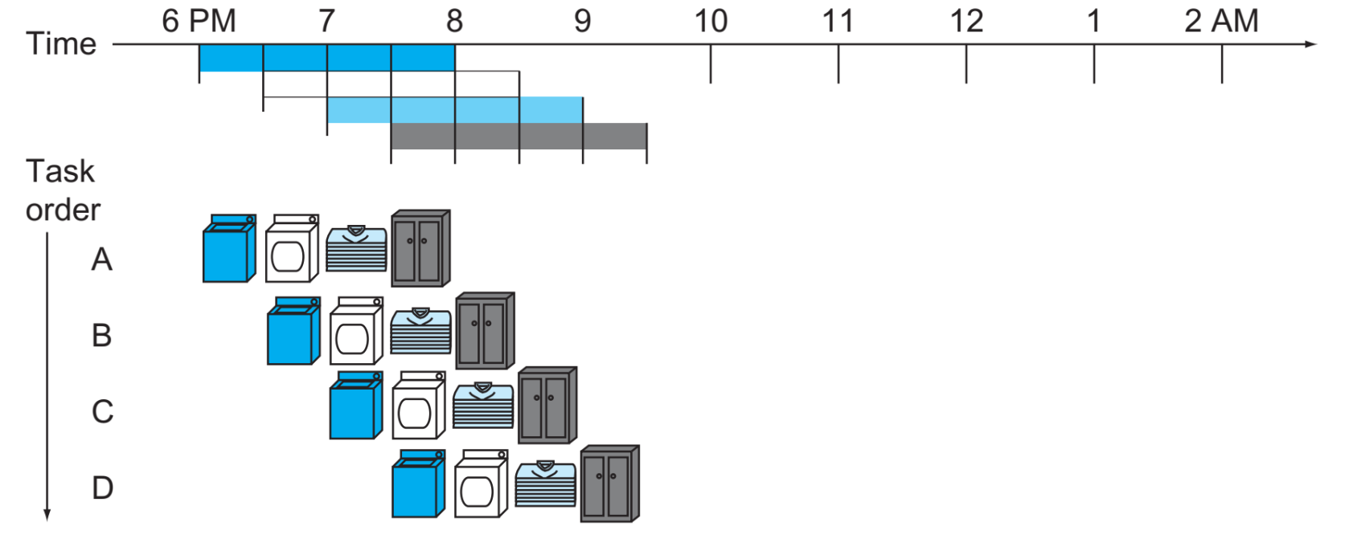
Pipelining
Computer Architecture-Spring 2020, AUT, Tehran, Iran

Slide 3
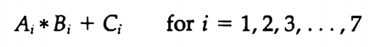
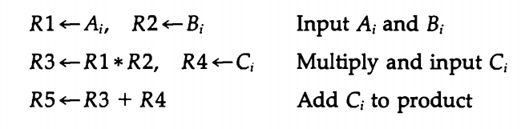
Pipelining
Computer Architecture-Spring 2020, AUT, Tehran, Iran

Slide 4
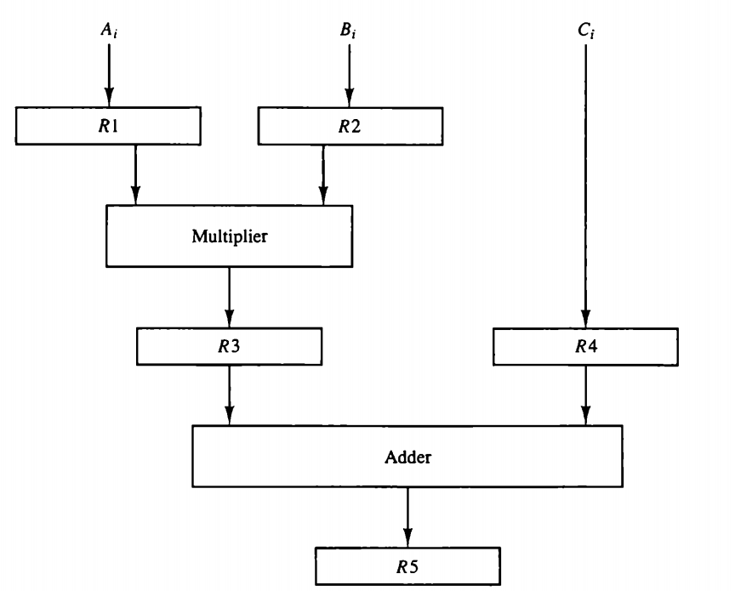
Pipelining
Computer Architecture-Spring 2020, AUT, Tehran, Iran

Slide 5
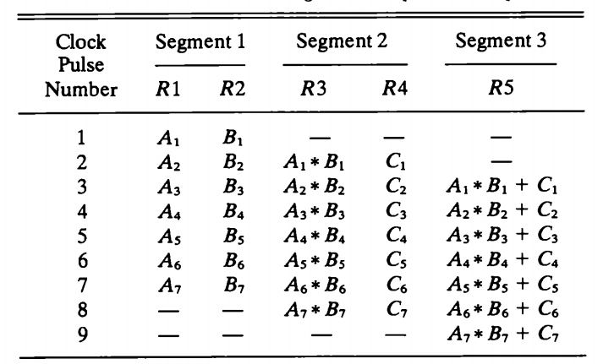
Pipelining
Computer Architecture-Spring 2020, AUT, Tehran, Iran

Slide 6
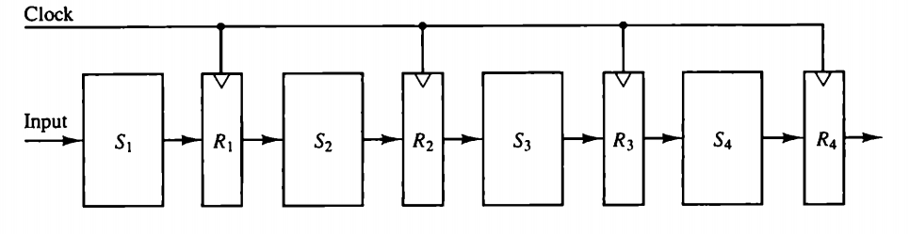
Pipelining
Computer Architecture-Spring 2020, AUT, Tehran, Iran

Slide 7
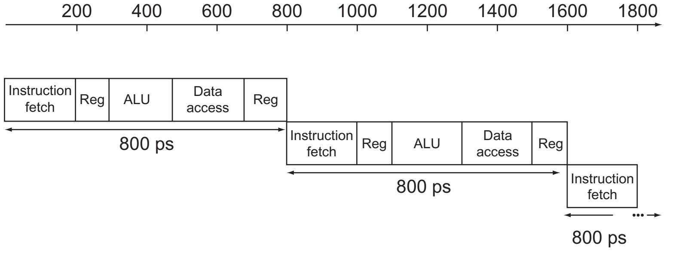
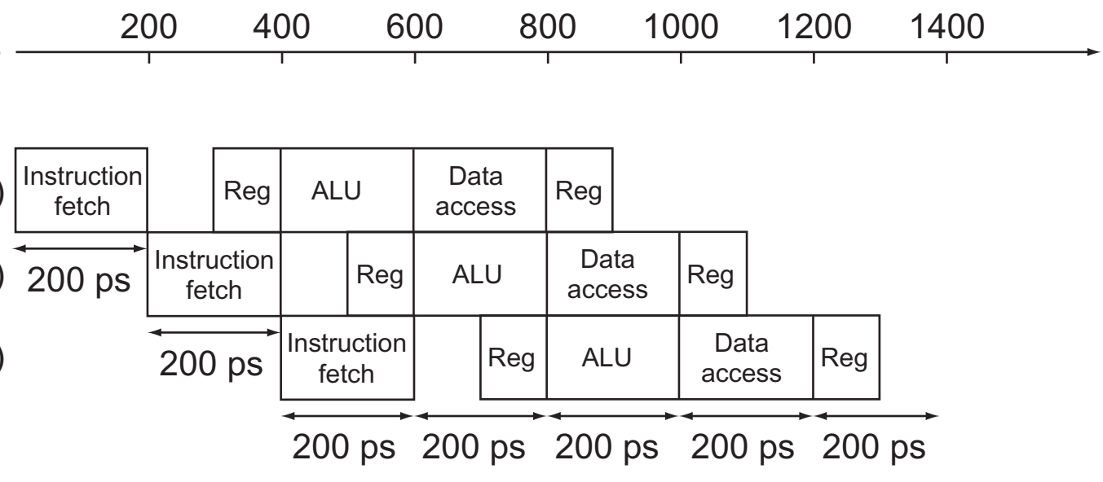
Pipelining
Computer Architecture-Spring 2020, AUT, Tehran, Iran

Slide 8
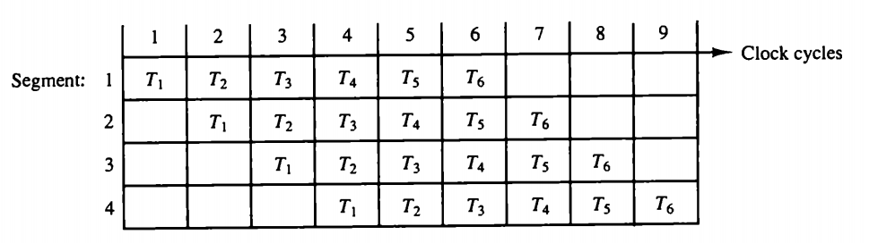
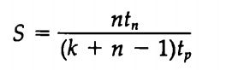
Pipelining
Maximum Speedup
Computer Architecture-Spring 2020, AUT, Tehran, Iran

Slide 9
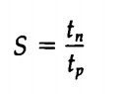
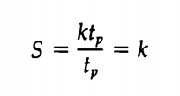
Pipelining Speedup
Computer Architecture-Spring 2020, AUT, Tehran, Iran

Slide 10
Pipelining Conflicts
Resource conflicts
Data dependency
Hardware interlocks
Operand forwarding
Delayed load
Branch difficulties
Prefetch target instruction
Branch target buffer
Loop buffer
Branch prediction
Delayed branch
Computer Architecture-Spring 2020, AUT, Tehran, Iran

Slide 11
Flynn’s Classification
Single Instruction Stream, single data stream (SISD)
Single Instruction Stream, multiple data stream (SIMD)
multiple Instruction Stream, single data stream (MISD)
multiple Instruction Stream, multiple data stream (MIMD)
Computer Architecture-Spring 2020, AUT, Tehran, Iran

